Slide 1
yield() (Engineering Software as a Service §3.8)
© 2013 Armando Fox & David Patterson, all rights reserved

Slide 2
Inelegant, This
ArrayList aList;
Iterator it = aList.iterator();
while (it.hasNext()) {
Object element = it.getNext();
// do some stuff with element
}
Goal of the code: do stuff with elements of aList
But iterator logic is all jumbled up with the code

Slide 3

Blocks (Anonymous λ)
(map '(lambda (x) (+ x 2)) mylist )
mylist.map { |x| x+2 }
(filter '(lambda (x) (even? x)) mylist)
mylist.select do |x| ; x.even? ; end
(map
'(lambda (x) (+ x 2))
(filter '(lambda (x) (even? x)) mylist))
mylist.select {|x| x.even?}.map {|x| x+2 }
Notes:
Map – perform function call to each element of a list
Anonymous Lambda – function definition not bound to an identifier, often passed as an argument to another function.
Filter – return all elements that evaluate true when passed to function

Slide 4
Turning Iterators Inside-Out
Java:
You hand me each element of a collection in turn
I will do some stuff
Then I will ask you if there’s any more left
Ruby:
Here is some code to apply to every element of the collection
You manage iteration or data structure traversal
Give me each element to do stuff to
Let’s do an example...
http://pastebin.com/T3JhV7Bk
Notes:
Inside a method that is called, yield passes control to block that was passed to the method. If yield had any arguments, they are passed as arguments to the block. The return value of the block is inserted at the location of the yield.

Slide 5
Iterators are Just One Nifty Use of yield
# in File class
def open(filename)
...open a file...
end
def close
...close a file...
end
# in your code
def do_everything
f = File.open("foo")
my_custom_stuff(f)
f.close()
end
Without yield(): expose 2 calls in other library
# in some other library
def open(filename)
...before code...
yield file_descriptor
...after code...
end
# in your code
def do_everything
File.open("foo") do |f|
my_custom_stuff(f)
end
end
With yield(): expose 1 call in other library

Slide 6
Blocks are Closures
A closure is the set of all variable bindings you can “see” at a given point in time
In Scheme, it’s called an environment
Blocks are closures: they carry their environment around with them
Result: blocks can help reuse by separating what to do from where & when to do it
We’ll see various examples in Rails
http://pastebin.com/zQPh70NJ
Notes:
Closures – have variables that are in scope when closure is used, not just at definition
Do…end are blocks, can see variables in scope when block is executed

Slide 7
END

Slide 8
In Ruby, every _____ accepts a(n) _____, but not vice-versa.
☐
yield() statement; iterator
☐
closure; iterator
☐
block; iterator
☐
iterator; block
Notes:
Every iterator accepts a block, but not vice-versa. A block is a type of closure. Yield is used to implement iterators.
False.
False.
False.
True.

Slide 9
END

Slide 10
Summary
Duck typing encourages behavior reuse
“mix-in” a module and rely on “everything is a method call—do you respond to this method?”
Blocks and iterators
Blocks are anonymous lambdas that carry their environment around with them
Allow “sending code to where an object is” rather than passing an object to the code
Iterators are an important special use case

Slide 11
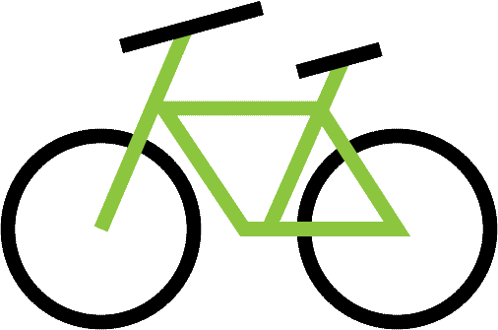
Summary (cont.)

Slide 12
END

Slide 13
Intro to RSpec & Unit Tests (Engineering Software as a Service §8.1)
© 2013 Armando Fox & David Patterson, all rights reserved

Slide 14
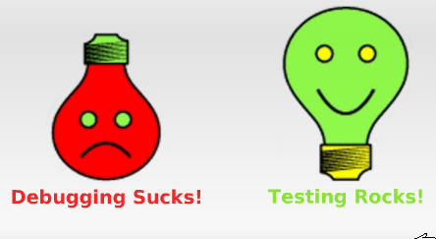
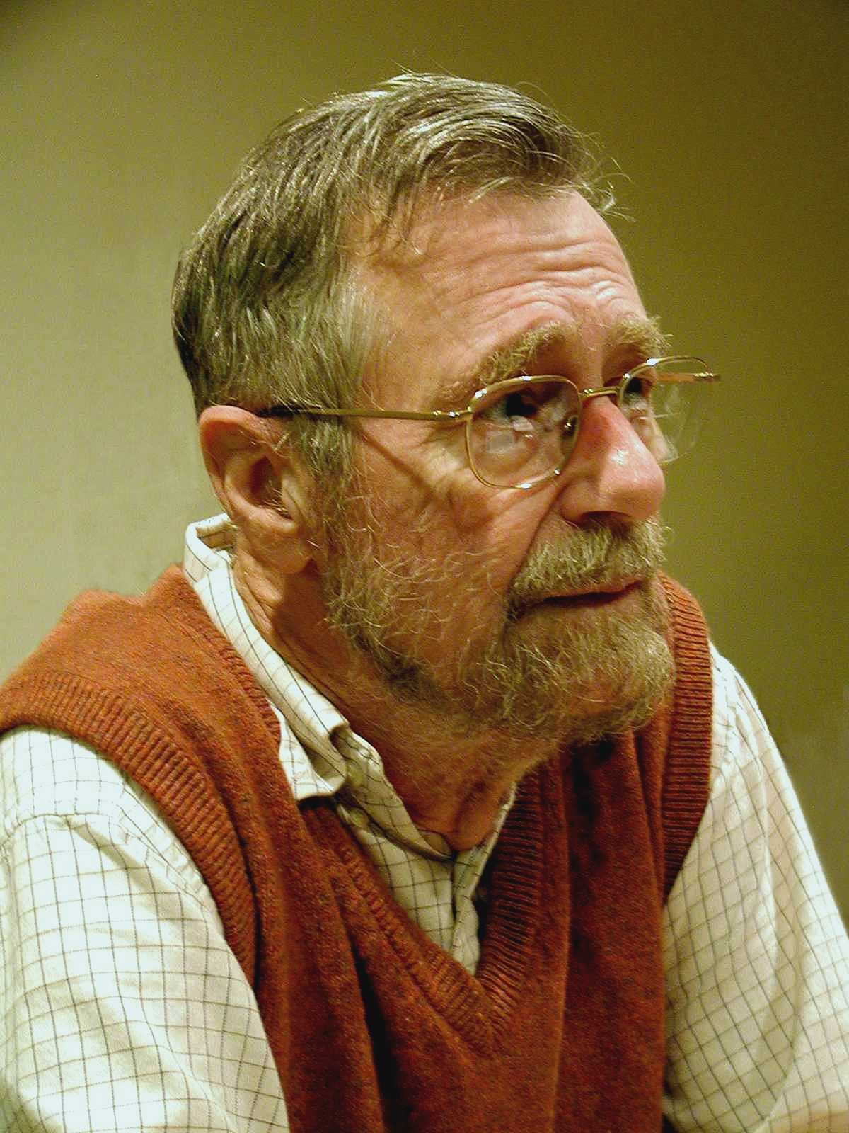
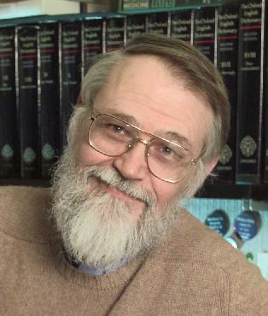
Testing can never demonstrate the _____ of errors in software, only their _______
absence
Debugging is twice as hard as writing the code in the first place. Therefore, if you write the code as cleverly as possible, you are, by definition, not smart enough to debug it.
presence
Notes:
Brian Kernighan, co-author of the C language book, many UNIX utilities
Turing Award winner Edsger Dijkstra, "father of object-oriented programming"
Seen in bathrooms at Google Inc. as part of "Testing on the Toilet" program

Slide 15
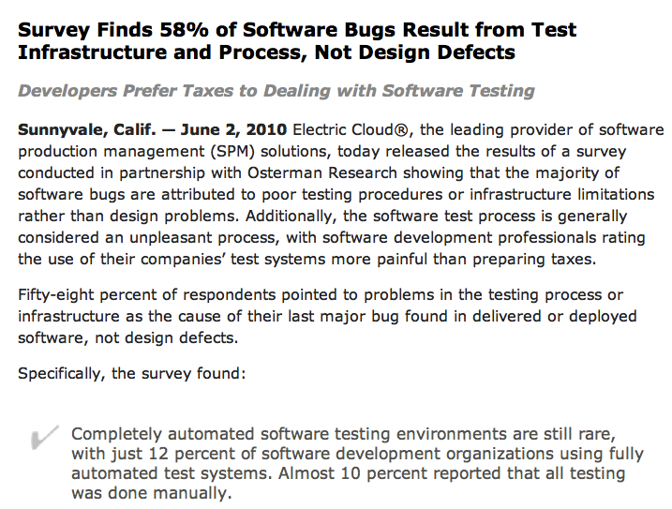

Slide 16
Testing Today
Before
developers finish code, some ad-hoc testing
“toss over the wall to Quality Assurance [QA]”
QA staff manually poke at software
Today/Agile
testing is part of every Agile iteration
developers test their own code
testing tools & processes highly automated
QA/testing group improves testability & tools

Slide 17
Testing Today
Before
developers finish code, some ad-hoc testing
“toss over the wall to Quality Assurance [QA]”
QA people manually poke at software
Today/Agile
testing is part of every Agile iteration
developers responsible for testing own code
testing tools & processes highly automated;
QA/testing group improves testability & tools
Software Quality is the result of a good process, rather than the responsibility of one specific group

Slide 18
BDD+TDD: The Big Picture
Behavior-Driven Design (BDD)
develop user stories (the features you wish you had) to describe how app will work
via Cucumber, user stories become acceptance tests and integration tests
Test-Driven Development (TDD)
step definitions for a new story, may require new code to be written
TDD says: write unit & functional tests for that code first, before the code itself
that is: write tests for the code you wish you had

Slide 19
Cucumber & RSpec
Cucumber describes behavior via features & scenarios (behavior driven design)
RSpec tests individual modules that contribute to those behaviors (test driven development)
Failing (red) Cucumber step
Failing (red) RSpec test
Passing (green) RSpec test
Passing (green) Cucumber step
Notes:
1st step is thinking of “code you wish you had”, assuming methods that if existed would make it a perfect match to the user story.
Rather than inside – out (start with building blocks and compose to provide desired functionality), go from users outside-in, to reduce wasted coding; e.g., until get to user view, won’t know what you really need. Especially Web apps, since easy to see what the user is doing.
Both cycles involve taking small steps and listening to the feedback
you get from the tools. We start with a failing step (red) in Cucumber
(the outer cycle). To get that step to pass, we’ll drop down to RSpec
(the inner cycle) and drive out the underlying code at a granular level
(red/green/refactor).
At each green point in the RSpec cycle, we’ll check the Cucumber cycle.
If it is still red, the resulting feedback should guide us to the next action in the RSpec cycle.
If it is green, we can jump out to Cucumber, refactor
if appropriate, and then repeat the cycle by writing a new failing
Cucumber step.

Slide 20
END

Slide 21
Which are true about BDD & TDD: a) requirements drive the implementation
b) they can be used only in Agile development
c) they embrace & deal with change
☐
Only (a)
☐
Only (a) & (b)
☐
Only (a) & (c)
☐
(a), (b) and (c)
Notes:
True
False. They can be used with plan-and-document as well.
True
False
False
True
False

Slide 22
END

Slide 23
FIRST, TDD, and Getting Started With Rspec (Engineering Software as a Service §8.2)
© 2013 Armando Fox & David Patterson, all rights reserved

Slide 24
Unit Tests Should Be FIRST
Fast
Independent
Repeatable
Self-checking
Timely

Slide 25
Unit Tests Should Be FIRST
Fast: run (subset of) tests quickly (since you’ll be running them all the time)
Independent: no tests depend on others, so can run any subset in any order
Repeatable: run N times, get same result (to help isolate bugs and enable automation)
Self-checking: test can automatically detect if passed (no human checking of output)
Timely: written about the same time as code under test (with TDD, written first!)

Slide 26
RSpec, a Domain-Specific Language for Testing
DSL: small programming language that simpifies one task at expense of generality
Examples: regex, SQL
RSpec tests are called specs or examples
Run the tests in one file: rspec filename
Red failing, Green passing, Yellow pending
Much better: running autotest
http://pastebin.com/LKTK36Pb
Notes:
Opinions vary on whether to test the views
Our position: views are user-facing, so use user stories to test => Cucumber

Slide 27
END

Slide 28
Which kinds of code can be tested Repeatably and Independently?
a) Code that relies on randomness (e.g. shuffling a deck of cards)
b) Code that relies on time of day (e.g. run backups every Sunday at midnight)
☐
Only (a)
☐
Only (b)
☐
Both (a) and (b)
☐
Neither (a) nor (b)
Notes:
Cannot be tested repeatably. (You might be able to do a statistical analysis).
Cannot be tested independently (unless you can stub the system clock).
False
False
False
True

Slide 29
END

Slide 30
The Web as a Client-Server System; TCP/IP Intro
(Engineering Software as a Service §2.1–2.2)
© 2013 Armando Fox & David Patterson, all rights reserved

Slide 31
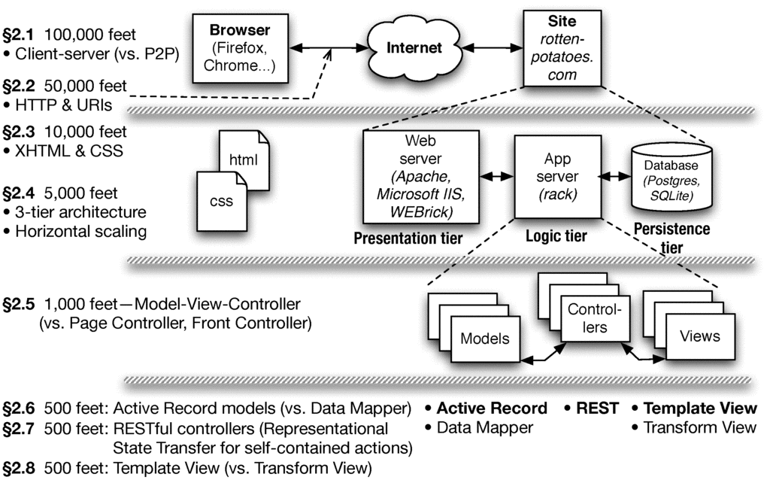
Chapter 2 Overview

Slide 32
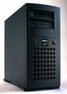
Web at 100,000 Feet
The web is a client/server architecture
It is fundamentally request/reply oriented
Web browser
Web site
Internet

Slide 33
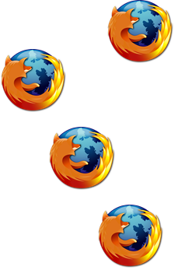
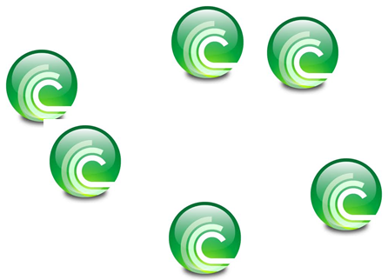
Client-Server vs. Peer-to-Peer
C
C
P
P
S
P
C
P
P
C
P
High-level architecture of the overall system
Soon we’ll talk about architecture “inside” boxes
Client & server each specialized for their tasks
Client: ask questions on behalf of users
Server: wait for & respond to questions, serve many clients
Design Patterns capture common structural solutions to recurring problems
Client-Server is an architectural pattern
Notes:
Firefox as client vs. BitTorrent as peer

Slide 34
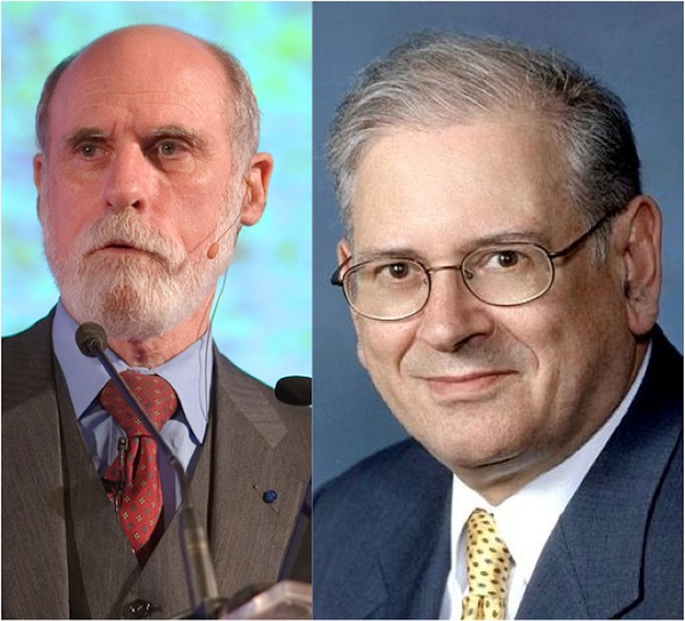
Nuts and Bolts: TCP/IP Protocols
IPv4 (Internet Protocol v4) address identifies a physical network interface with four octets, e.g. 128.32.244.172
Special address 127.0.0.1 is “this computer”, named localhost, even if not connected to the Internet!
TCP/IP (Transmission Control Protocol/Internet Protocol)
IP: no-guarantee, best-effort service that delivers packets from one IP address to another
TCP: make IP reliable by detecting “dropped” packets, data arriving out of order, transmission errors, slow networks, etc., and respond appropriately
TCP ports allow multiple TCP apps on same computer
Vint Cerf & Bob Kahn: 2004 Turing Award for Internet architecture & protocols, incl. TCP/IP
GET /bears/
GET /bears/
HTTP/0.9 200 OK
HTTP/0.9 200 OK
Notes:
Berkeley Unix was first open-source reference implementation of TCP/IP in an open-source OS!

Slide 35
Web at 100,000 Feet
The web is a client/server architecture
It is fundamentally request/reply oriented
Domain Name System (DNS) is another kind of server that maps names to IP addresses
Web browser
Web site
DNS server

Slide 36
Now That We’re Talking, What Do We Say? Hypertext Transfer Protocol (HTTP)
an ASCII-based request/reply protocol for transferring information on the Web
HTTP request includes:
request method (GET, POST, etc.)
Uniform Resource Identifier (URI)
HTTP protocol version understood by the client
headers—extra info regarding transfer request
HTTP response from server
Protocol version & Status code =>
Response headers
Response body
HTTP status codes:
2xx — all is well
3xx — resource moved
4xx — access problem
5xx — server error
Notes:
DEMO: nc –l 8000, then GET /la/di/da
DEMO: telnet www.cs.berkeley.edu 80
GET /bears/ HTTP/1.0

Slide 37
END

Slide 38
Assuming “>” means “relies on”, which statement is NOT correct:
☐
DNS > IP
☐
HTTP > TCP > IP
☐
TCP > DNS
☐
All the above are correct
Notes:
1. True. DNS relies on IP
2. True. HTTP relies on TCP which relies on IP
3. False. TCP does not rely on DNS – can just use IP addresses to work
4. False.

Slide 39
END

Slide 40
Cookies
Observation: HTTP is stateless
Early Web 1.0 problem: how to guide a user “through” a flow of pages?
use IP address to identify returning user? ✖ public computers, users sharing single IP
embed per-user junk into URI query string? ✖ breaks caching
Quickly superseded by cookies
Watch: screencast.saasbook.info
Rails manages tamper-evident cookies for you
Notes:
Demo: see cookie arriving from Google.com
curl -D - http://www.google.com -o /dev/null

Slide 41
Uses of Cookies
Most sites quickly realized that the per-user state could be used for lots of things:
customization (“My Yahoo”)
click tracking/flow tracking
authentication (logged in or not)
Which of these could be implemented on the client side? Which ones shouldn’t be and why?
A golden rule: don’t trust the client—cookies must be tamper-evident

Slide 42
END

Slide 43
A ____ can create and modify cookies; the ____ is responsible for including the correct cookie with each request
☐
Browser; SaaS app
☐
SaaS app; browser
☐
HTTP request; browser
☐
SaaS app; HTTP response
Notes:
False. A browser cannot create and modify cookies.
True. A SAAS app can create and modify cookies; the browser is responsible for including the correct cookie with each request.
False. A HTTP request cannot create and modify cookies.
False. An HTTP response is not responsible for including the correct cookie with each request.

Slide 44
END

Slide 45
3-Tier Shared-Nothing Architecture & Scaling
(Engineering Software as a Service §2.4)
© 2013 Armando Fox & David Patterson, all rights reserved

Slide 46
Chapter 2 Overview

Slide 47
Dynamic Content Generation
In Olden Days, most web pages were (collections of) plain old files – static content
But most interesting Web 1.0/e-commerce sites run a program to generate each “page”
Originally: templates with embedded code “snippets”
Eventually, code became “tail that wagged the dog” and moved out of the Web server

Slide 48

Sites That are Really Programs (SaaS)
How do you:
“map” URI to correct program & function?
pass arguments?
invoke program on server?
handle persistent storage?
handle cookies?
handle errors?
package output back to user?
Frameworks support these common tasks
persistence
Filesystem
or database
logic (app)
your app
Common Gateway Interface (CGI)
presentation (Web server)
client (browser)
Notes:
HTTP stateless: IP addr? cookies? sessions in DB? other?
(why would you consider a specialized store?)

Slide 49
Developer Environment vs. Medium-Scale Deployment
file.sqlite3
MySQL
PostgreSQL
Database
cache
SQLite adapter
MySQL adapter
MySQL adapter
MySQL adapter
“Dynos” running
apps
Rails library
Rails library
Rails library
Rails library
rack
rack
rack
rack
Webrick
thin
thin
thin
HTTP servers & static asset caches
Page cache
Apache w/mod_rails + caching mode
Large-scale curated deployment, e.g. Heroku
Developer
Medium-scale deployment
Notes:
Why small machine for DB?
How many processes & how many machines in each example?
WEBrick – Ruby library for HTTP/HTTPS server, used by Rails to test apps in development
Thin – thin interface in place of WEBrick
Rack – API for web apps
Dyno – lightweight container on Heroku running single user-specified command, simpler than a VM.

Slide 50
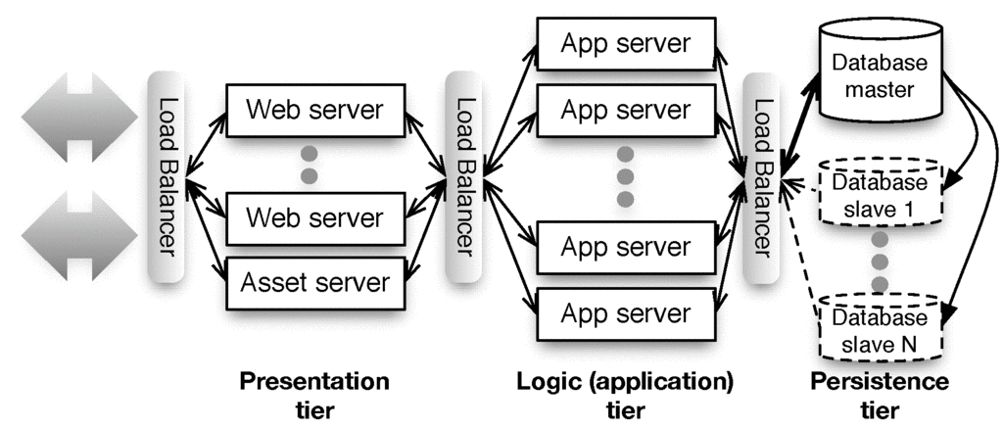
“Shared Nothing”

Slide 51
Sharding vs. Replication
Partition data across independent “shards”?
+ Scales great
Bad when operations touch >1 table
Example use: user profile
Replicate all data everywhere?
+ Multi-table queries fast
Hard to scale: writes must propagate to all copies => temporary inconsistency in data values
Example: Facebook wall posts/“likes”
App server
users A-J
App server
users K-R
App server
users S-Z
App server
All users
App server
All users
App server
All users
Notes:
MESSAGE: can't magically scale persistence tier. Subject of active R&D, including NoSQL and other stuff we will learn about in 2nd half of class.

Slide 52
Summary: Web 1.0 SaaS
Browser requests web resource (URI) using HTTP
HTTP is a simple request-reply protocol that relies on TCP/IP
In SaaS, most URI’s cause a program to be run, rather than a static file to be fetched
HTML is used to encode content, CSS to style it visually
Cookies allow server to track client
Browser automatically passes cookie to server on each request
Server may change cookie on each response
Typical usage: cookie includes a handle to server-side information
That’s why some sites don’t work if cookies are completely disabled
Frameworks make all these abstractions convenient for programmers to use, without sweating the details
...and help map SaaS to 3-tier, shared-nothing architecture

Slide 53
END

Slide 54
Match the terms:
(a) presentation tier, (b) logic tier, (c) persistence tier
☐
(a) Apache web server (b) Rack+Rails (c) Relational database
☐
(a) Firefox (b) Apache web server (c) PostgreSQL
☐
(a) Microsoft Internet Information Server (b) Rack+Rails (c) Apache web server
☐
(a) Firefox (b) Microsoft Internet Information Server (c) MySQL
Notes:
True.
False. Firefox is in the client and Apache is presentation tier.
False. Apache is not in the persistence tier.
False. Firefox is not in the presentation tier.

Slide 55
END

Slide 56
HTML+CSS
(Engineering Software as a Service §2.3)
© 2013 Armando Fox & David Patterson, all rights reserved

Slide 57
Chapter 2 Overview

Slide 58
Text
Introduction
This article is a review of the book
Dietary Preferences of Penguins,
by Alice Jones and Bill Smith. Jones
and Smith's controversial work makes
three hard-to-swallow claims about
penguins:
First, that penguins actually prefer
tropical foods such as bananas and
pineapple to their traditional diet
of fish
Second, that tropical foods give
penguins an odor that makes them
unattractive to their traditional
predators

Slide 59
Hypertext Markup Lang. (HTML)
<h1>Introduction</h1>
<p>
This article is a review of the book
<i>Dietary Preferences of Penguins</i>,
by Alice Jones and Bill Smith. Jones and Smith's controversial work makes three hard-to-swallow claims about penguins:
</p>
<ul>
<li>
First, that penguins actually prefer tropical foods such as bananas and pineapple to their traditional diet of fish
</li>
<li>
Second, that tropical foods give penguins an odor that makes them unattractive to their traditional predators
</li>
</ul>
Notes:
markup indicates *structure* of document (used to also indicate visual style, but that's changed)
markup and text are both plain ASCII
elements are demarcated by open and close tags, and can be nested.
<h1></h1> - heading 1
<p></p> - paragraph
<ul>/</ul> unordered (bulleted) list, <li>/</li> list item

Slide 60
Introduction
This article is a review of the book Dietary Preferences of Penguins, by Alice Jones and Bill Smith. Jones and Smith's controversial work makes two hard-to-swallow claims about penguins:
First, that penguins actually prefer tropical foods such as bananas and pineapple to their traditional diet of fish
Second, that tropical foods give penguins an odor that makes them unattractive to their traditional predators
...
<h1>Introduction</h1>
<p>
This article is a review of the book
<i>Dietary Preferences of Penguins</i>,
by Alice Jones and Bill Smith. Jones
and Smith's controversial work makes
three hard-to-swallow claims about
penguins:
<ul>
<li>
First, ...

Slide 61
HTML
Document = Hierarchy of elements
inline (headings, tables, lists, paragraphs)
embedded (images, JavaScript)
forms—allow user to submit simple input (text, radio/check buttons, dropdown menus...)
Elements delimited by <tag>....</tag>
Some have content: <p>Hello world</p>
Some have attributes: <img src="http://...">
id and class attributes useful for styling

Slide 62
Cascading Style Sheets (CSS) Separate Content from Presentation
<link rel="stylesheet" href="http://..."/> (inside <head> element): what stylesheet(s) go with this HTML page
HTML id & class attributes important in CSS
id must be unique within this page
same class can be attached to many elements
<div id="right" class="content">
<p>
I'm Hank. I teach CSCE606 and do
research in the EDA Lab.
</p>
</div>
Notes:
Link – external reference, rel = relationship, href is URL
Id – ID of element
Class – classnames for element
Div – division/section in document, group elements for formatting

Slide 63
CSS Selectors Identify Specific Elements for Styling
<div class="pageFrame" id="pageHead"> <h1> Welcome, <span id="custName">Hank</span> </h1>
<img src="welcome.jpg" id="welcome"/> </div>
tag name: h1
class name: .pageFrame
element ID: #pageHead
tag name & class: div.pageFrame
tag name & id: img#welcome (usually redundant)
descendant relationship: div #custName
Attributes inherit browser defaults unless overridden
Goal: HTML markup contains no visual styling information
both of these match the outer div above. Don’t do this!
Notes:
Span – group inline elements in document
visit Csszengarden.com
also turn off all styles

Slide 64
END

Slide 65
Which CSS selector will select only the word “bar” for styling:
<p class="myClass">foo, <span class="myClass">bar<span></p>
☐
span.myClass
☐
p .myClass
☐
.myClass span
☐
All of these
Notes:
Span is an element used to group several HTML elements.
“element1.class1” will select element1 with class1. “element1#id1” will select element1 with id1. “element1 element2” will select element2 that is a child of element1. “element1, element2” will select element1 and element2.
1. True. This will select the span element with class myClass, which contains bar.
2. True. This will select the paragraph, which contains foo and bar, and then the myClass element in the paragraph, which is the span with bar.
3. True. This will select all elements with class myClass, which is p and span, and then the span, which has bar.
4. True.

Slide 66
END

